Slide 1
Graph Data Structure And Algorithms

Slide 2
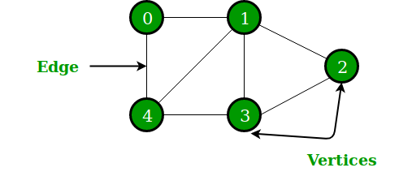
A Graph is a non-linear data structure consisting of nodes and edges. The nodes are sometimes also referred to as vertices and the edges are lines or arcs that connect any two nodes in the graph. More formally a Graph can be defined as,
A Graph consists of a finite set of vertices(or nodes) and set of Edges which connect a pair of nodes.

Slide 3
Graph and its representations
The following two are the most commonly used representations of a graph. 1. Adjacency Matrix 2. Adjacency List

Slide 4
Adjacency Matrix:
Adjacency Matrix is a 2D array of size V x V where V is the number of vertices in a graph. Let the 2D array be adj[][], a slot adj[i][j] = 1 indicates that there is an edge from vertex i to vertex j. Adjacency matrix for undirected graph is always symmetric. Adjacency Matrix is also used to represent weighted graphs. If adj[i][j] = w, then there is an edge from vertex i to vertex j with weight w.
Pros: Representation is easier to implement and follow. Removing an edge takes O(1) time. Queries like whether there is an edge from vertex ‘u’ to vertex ‘v’ are efficient and can be done O(1).
Cons: Consumes more space O(V^2). Even if the graph is sparse(contains less number of edges), it consumes the same space. Adding a vertex is O(V^2) time.

Slide 5
Adjacency List:
An array of lists is used. The size of the array is equal to the number of vertices. Let the array be an array[]. An entry array[i] represents the list of vertices adjacent to the ith vertex. This representation can also be used to represent a weighted graph. The weights of edges can be represented as lists of pairs.
Pros: Saves space O(|V|+|E|) . In the worst case, there can be C(V, 2) number of edges in a graph thus consuming O(V^2) space. Adding a vertex is easier.
Cons: Queries like whether there is an edge from vertex u to vertex v are not efficient and can be done O(V).

Slide 6
Depth First Search or DFS for a Graph
Depth First Traversal (or Search) for a graph is similar to Depth First Traversal of a tree. The only catch here is, unlike trees, graphs may contain cycles (a node may be visited twice). To avoid processing a node more than once, use a boolean visited array.

Slide 7
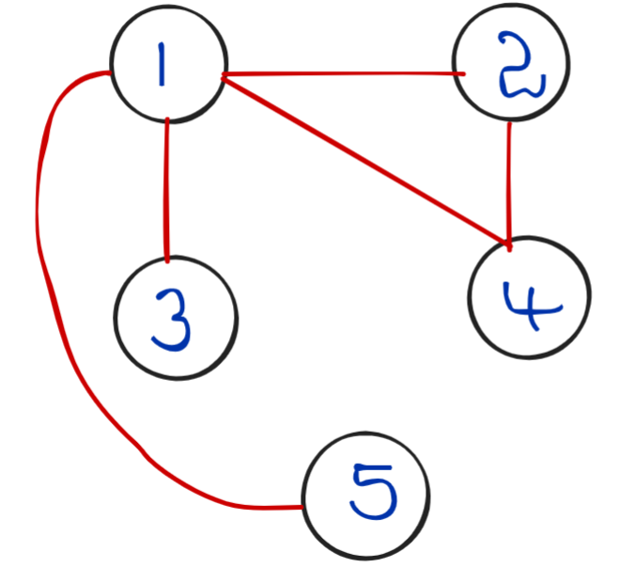
Output: 2 4 1 3 5

Slide 8
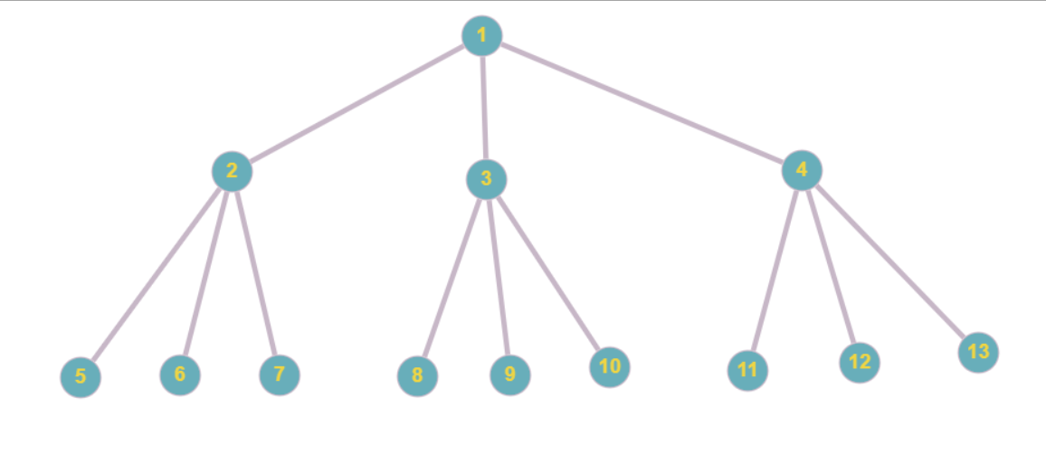
Breadth-First Search(BFS) : Level Order Traversal
Problem Statement: An Undirected Graph will be given. Return a vector of all the nodes of the Graph by Breadth-First Search ( BFS ) Technique.
Output: 1 , 2 , 3 , 4 , 5 , 6 , 7, 8 , 9 , 10, 11, 12, 13

Slide 9
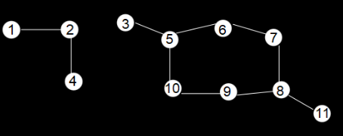
Detect a cycle in Undirected Graph : Breadth-First Search
Problem Statement: Given an undirected Graph, check for a cycle using BFS (Breadth-First Search) Traversal.

Slide 10
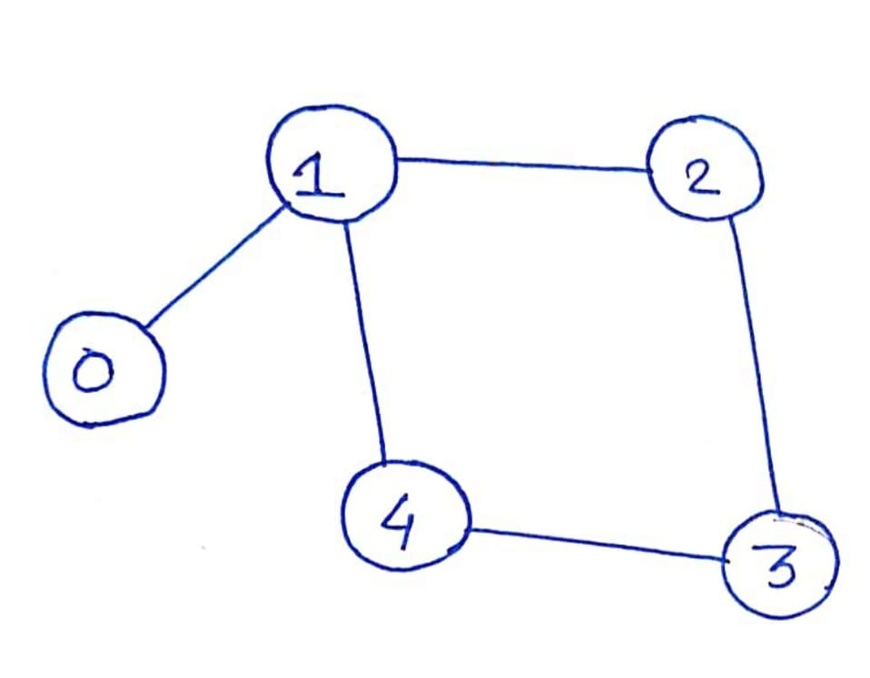
Cycle Detection in Undirected Graph using DFS
Problem Statement: Given an undirected graph with V vertices and E edges, check whether it contains any cycle or not.

Slide 11
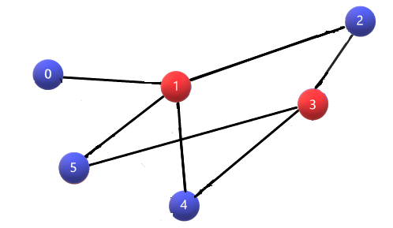
Bipartite Check using BFS – If Graph is Bipartite
Problem Statement: Given is a 2D adjacency list representation of a graph. Check whether the graph is Bipartite graph. (Note: In a Bipartite graph, one can color all the nodes with exactly 2 colors such that no two adjacent nodes have the same color)

Slide 12
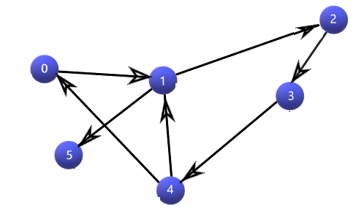
Detect A Cycle in Directed Graph using DFS
Problem Statement: Given is a 2D adjacency list representation of a directed graph. Check whether the graph has cycles are not.

Slide 13
Topological Sort (BFS)
Problem statement: Given a graph, find the topological order for the given graph.
Topological sort: The linear ordering of nodes/vertices such that if there exists an edge between 2 nodes u,v then ‘u’ appears before ‘v’.

Slide 14
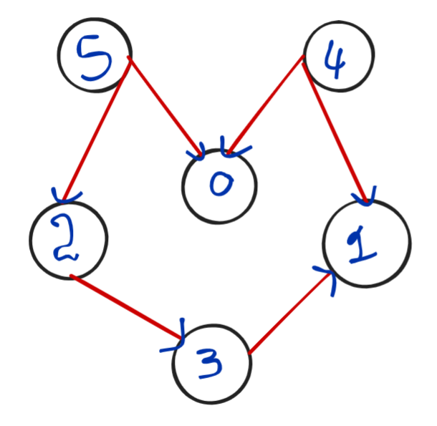
Output: 4 5 2 0 3 1

Slide 15
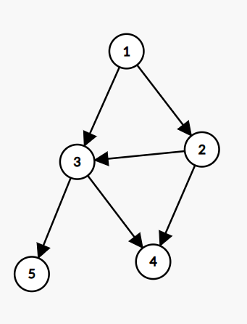
Topological Sort Using DFS
Problem Statement: Given a DAG( Directed Acyclic Graph ), print all the vertex of the graph in a topologically sorted order. If there are multiple solutions, print any.
One of the solutions is 1,2,3,5,4

Slide 16
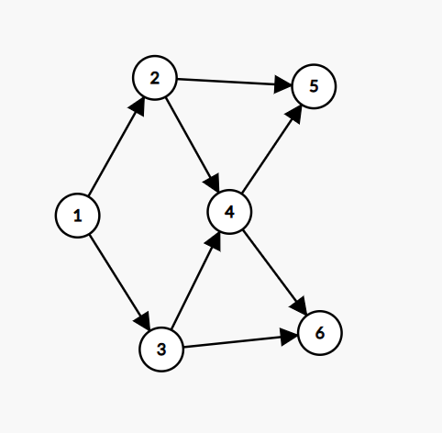
Output: One of the solution is 1,2,3,4,5,6

Slide 17
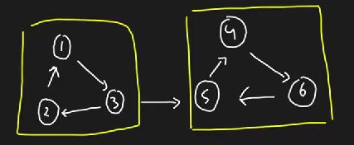
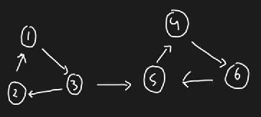
Kosaraju’s Algorithm for Strongly Connected Components(SCC)
Problem Statement: Given a Directed Graph with V vertices (Numbered from 0 to V-1) and E edges, Find the number of strongly connected components in the graph.

Slide 18
Dijkstra’s Algorithm – Shortest distance
Problem Statement: Given a weighted, undirected, and connected graph of V vertices and E edges, Find the shortest distance of all the vertex’s from the source vertex S.
Note: The Graph doesn’t contain any negative weight cycle.

Slide 19
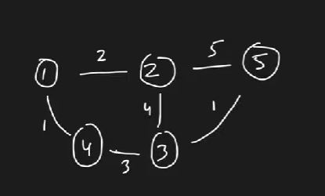
Example 1:
Input: Adj list : [[1,2,2],[1,4,1],[2,1,2],[2,3,4],[2,5,5],[3,2,4],[3,4,3],[3,5,1],[4,1,1],[4,3,3],[5,2,5],[5,3,1]]
Output: [0,2,4,1,5]

Slide 20
Bellman-Ford Algorithm – Shortest Distance with Negative Edge
Problem Statement: Given a weighted directed graph with negative edge weights with n nodes and m edges. Nodes are labeled from 0 to n-1, the task is to find the shortest distance from the source node to all other nodes. Output “-1” if there exists a negative edge weight cycle in the graph. Note: edges[i] is defined as u, v and weight.

Slide 21
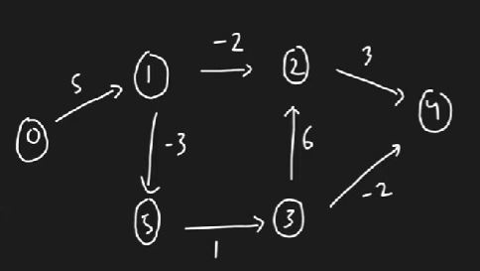
Example 1:
Input: Edges : [[0,1,5],[1,5,-3],[1,2,-2],[2,4,3],[3,2,6],[3,4,-2],[5,3,1]]
Output: [0,5,3,3,1,2]

Slide 22
Minimum Spanning Tree – MST using Prim’s Algo
Problem Statement: Given a weighted, undirected, and connected graph of V vertices and E edges. The task is to find the sum of weights of the edges of the Minimum Spanning Tree.
Definition: A minimum spanning tree consists of N nodes and N-1 edges connecting all the nodes which have the minimum cost(sum of edge weights).
Note: It is known as a tree since a tree doesn’t have cycles involved. A graph with N nodes and N-1 edges is equivalent to a tree.

Slide 23
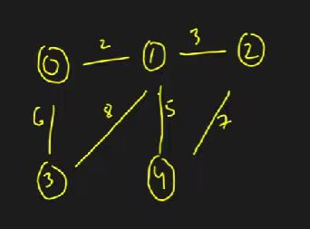
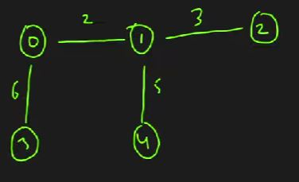

Slide 24
Minimum Spanning Tree – MST using Kruskal’s Algo

